Slide 1
RING DOWN FIREBAR CONFERENCE SERVER (RFCS)
STATE OF THE ART CRASH PHONE & CRASH ALARM SYSTEM
XOP Networks - Confidential
1
Notes:
1

Slide 2
XOP Networks - Introduction
Started in 2002
Headquartered in Dallas, Texas
Ex Alcatel/DSC/MCI Management Team
Manufacture Conference Bridges, Service Nodes, Application Servers, VAS equipment
Sell through OEMs, Resellers, Direct
Multiple Wireline/Wireless Operators
Multiple Fortune 100 companies
US Army, Navy and Air Force
Global sales and support
Meets all requirements of FAA (AFI 13-204V3).
Equivalent & in many ways superior to Forum Alert III

Slide 3
RFCS Capabilities
One Product Platform, two distinct applications:
Crash Phone – Red Phone in Tower goes off-hook, and immediately calls responder Stations (Firestation, Police, 911 Dispatch, etc.). As they pick-up they are automatically connected to a multi-party conference
Crash Alarm – Simple push of Alarm button sends alerts to responders. Triggers bells, strobe-lights, horns, audio messages, open doors, turn-on lights.

Slide 4
Crash Phone Conference System Operation
An incoming phone call or Off Hook triggers the Firebar
System calls-out to a predetermined group of people
As they answer, they are joined to a multi-party conference
If Primary Station does not answer, RFCS calls out to secondary station (cell, landline, PBX phone) via existing PBX
Incoming call or off-hook
launches multiple
out going calls
As people pickup
their phones, they are
automatically placed on an
audio conference
Firebar
Press a
speed
dial key
Telecom Platform
RFCS

Slide 5
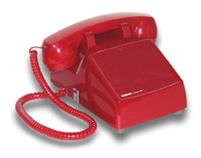
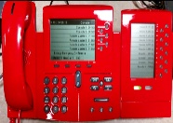
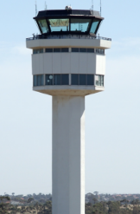
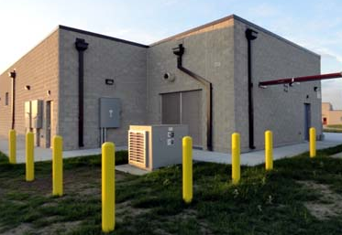
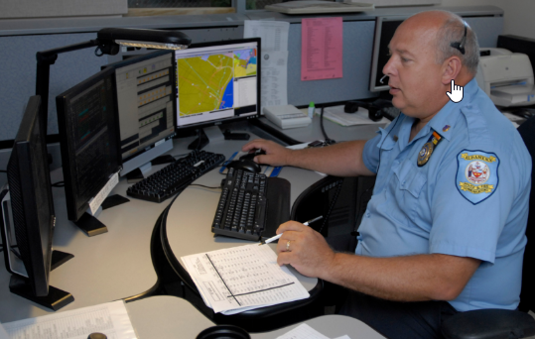
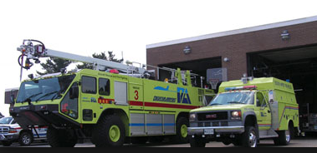
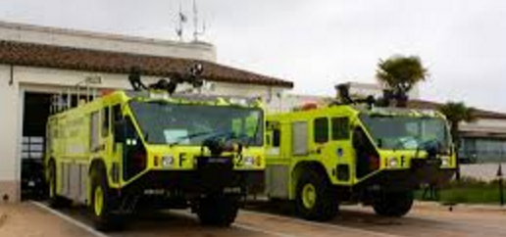
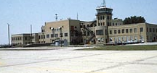
Typical Crash Phone Airport Network
2
Off Hook at ATC triggers the Ring down Firebar Conference
with a predetermined group of people.
1
Pilot informs ATC
of trouble
Airport Lighting
Vault (secure)
2 U Chassis per system
(Located in Lighting Vault next to tower)
Initiator Phone Digital or Analog
XOP RFCS
ATC Tower
3
As people go off-hook they are joined into a multi-party audio conference
ECC 911 Dispatch
Fire Station
West
Fire Station
East
Airport Admin
Building
Recording/Paging
Interface

Slide 6
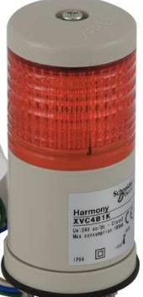
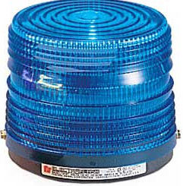
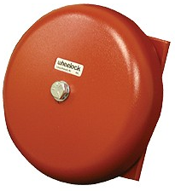
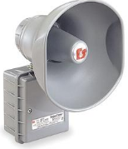
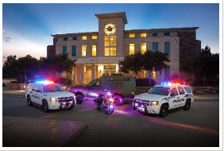
Typical Airport Crash Alarm Network
ATC Tower
Hit the Red- button to initiate
System will:
Ring Bells
Light Strobes
Send Recorded Messages to Responders
Send Alerting Tones to Paging Systems
Open Fire Station doors
ATC Alarm
Indicator
Airport Lighting
Vault (secure)
XOP RFCS
System Automatically triggers all Bells, Horns & Strobes and will be activated continuously until Initiator Cancels the alarm
Fire Station
West
Fire Station
East
Airport Admin
Building
Police
Station
911 Dispatch

Slide 7
Combined Crash Phone & Crash Alarm Network
System will:
Can initiate Voice Call and Conference from simple off-hook
Ring Bells
Light Strobes
Send Recorded Messages to Responders
Send Alerting Tones to Paging Systems
Open Fire Station doors
ATC Tower
Hit the Red- button to initiate
Emergency Initiator can use voice or alarm or both
Airport Lighting
Vault (secure)
XOP RFCS
Initiator Phone Digital or Analog
Alarm Signaling
Voice Calls
Paging
Interface
Fire Station
West
Fire Station
East
Airport Admin
Building
Police
Station
911 Dispatch

Slide 8
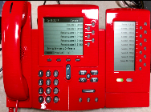
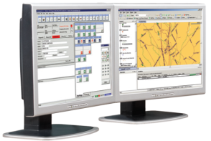
Ring-down Firebar Conference System (RFCS) Network - Standard
Ringdown Firebar
Conference System
Standalone Crash Phone Ring-down Firebar equipment
Scalable from 8 ports to 96 ports
Can support direct analog lines and/or SIP Ports
FXS Interface for direct connectivity to Field Phones (RED emergency Phones)
FXO Interface for direct connectivity to PSTN/On-site PBX
Digital Master Control Phone(s) for viewing individual line status (on-hook, off-hook, ringing etc.)
Web Portal for provisioning and administration
Support for 10000 feet loops (standard)
Support for Long Loop lengths , 30,000 feet via external loop extenders (optional)
Scheduled (Daily, Weekly etc.) recurring dial-outs for routine automated Crash Phone testing
Multiple designated trigger phones
Multiple hysteresis controls for preventing un-intentional triggers
Web Portal for viewing and controlling on going Crash Phone conferences
Built-in recording capability
Hardened for outside plant deployment
Analog Master
Phone at ATC
Tower
Or:
RFCS
Digital
Master
Phone at ATC
Tower
Analog
Loops
Tellabs 291
Replacement
PTT Field
Phones
PA/ Strobe
911 Dispatch
XOP Networks - Confidential
8

Slide 9
RFCS – Ringdown Firebar Conference System
Platform details
Cisco Router based hardware
2 RU high, 19” wide, 15” deep
FXS, FXO and T1/E1/PRI Network Interface Modules
SIP Trunk (optional)
XOP Conference Software running on Cisco Service Module
Web Portal for System Administration/ Control
Solid State Hard Drive
Standard FXS NIC (10 Kft)
Loop extenders (30 Kft) (optional)
Support for 2500 sets
Support for IP Phones (optional)
High Availability (optional)
Information Assurance - Enhanced Security (optional)
SNMP Monitoring (optional)
Ringdown Firebar
Conference System
XOP Conf SW
Network Interface
Modules (FXS/FXO/PRI)
Service Module

Slide 10
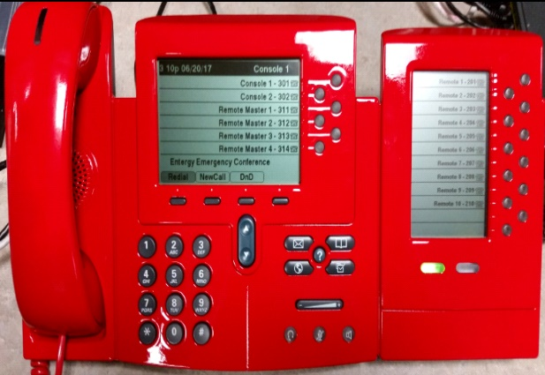
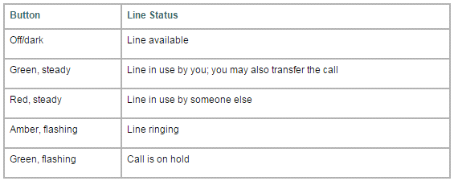
Console/ATC Phone w/line status
Cisco IP Phone +
Expansion module
Expansion Module LED Operation

Slide 11
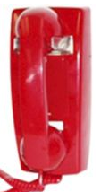
Field & Tower Phones For Crash Phone
Dial less 2500 set, 0.5 REN
Push-to -talk Handset for reducing back ground noise
Available in desk or wall mount configurations
Available in Black or Red color

Slide 12
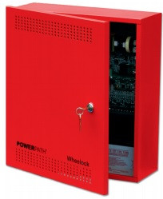
Alerting System Terminals
Manufactured by Wheelock Company
Press to initiate
Press, rotate & release to cancel
Approvals include: UL Standard 464, Factory Mutual (FM), California State Fire Marshal (CSFM), New York (MEA) and Chicago (BFP)
With Standby Power
Low frequency aluminum shells for better audibility through walls, doors and other structures

Slide 13
For additional information please visit our web site at
www.xopnetworks.com
For sales inquiries, please contact
Chris Bussey:
O:972-590-0206
C:469-360-6061
cbussey@xopnetworks.com
For general inquiries, please call
Main: 972-590-0200
Alternate: 972-590-0201
214-564-2263
Notes:
13

