Slide 1

RING DOWN FIREBAR CONFERENCE SERVER (CRASH PHONE) PRESENTATION
XOP Networks - Confidential
1
Notes:
1

Slide 2
XOP Networks - Introduction
Started in 2003
Headquartered in Dallas, Texas
Ex Alcatel/DSC/MCI Management Team
Manufacture Conference Bridges, Crash Phone System, Service Nodes, Application Servers, VAS equipment
Sell through OEMs, Resellers, Direct
  Multiple Wireline/Wireless Operators
  Multiple Fortune 100 companies
  US Army, Navy and Air Force
  Airports
Global sales and support

Slide 3


What is a Crash Phone System?
An incoming phone call or Off Hook triggers the Dial-out audio conference also called a Firebar
System calls-out to a predetermined group of people
As they answer, they are joined into a multi-party conference
If Primary Station does not answer, RFCS calls out to secondary station (cell, landline, PBX phone) via existing PBX
Incoming call or off-hook
launches multiple
out going calls
As people pickup
their phones, they are
automatically placed on an
audio conference
Firebar
Press a
speed
dial key
Telecom Platform
RFCS
RFCS: Ring Down Firebar Conference Server

Slide 4

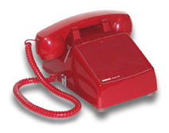
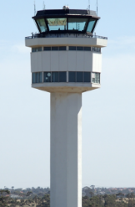
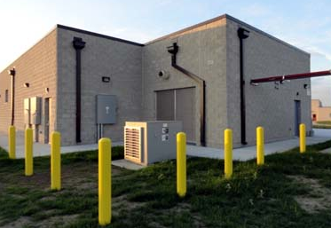

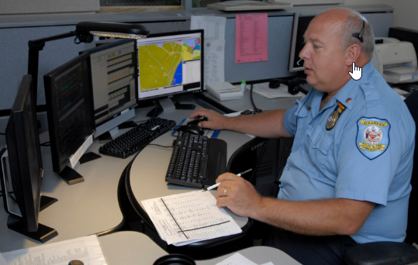
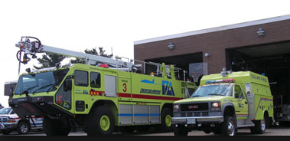
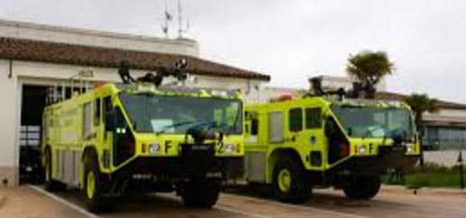
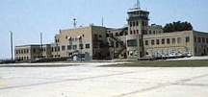
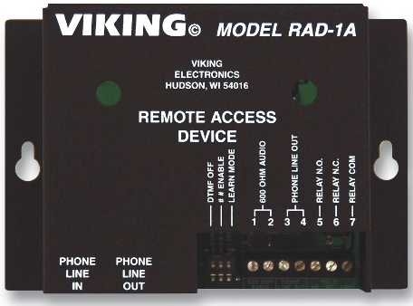
Typical Analog Crash Phone Network
2
Off Hook at ATC triggers the Ring down Firebar Conference
with a predetermined group of people.
1
Pilot informs ATC
of trouble
Airport Lighting
Vault (secure)
Cisco Router with XOP’s
Emergency
Conferencing Software
Initiator Phone Digital or Analog
XOP RFCS
ATC Tower
3
As people go off-hook they are joined into a multi-party audio conference
ECC 911 Dispatch
Fire Station
West
Fire Station
East
Airport Admin
Building
Recording/Paging
Interface
RFCS: Ring Down Firebar Conference Server

Slide 5

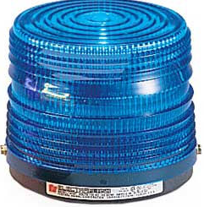
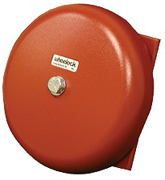
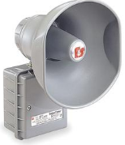
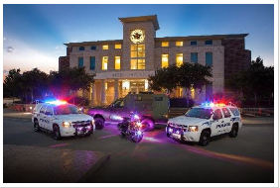
Typical Airport Alerting Network
System will
Ring Bells
Light Strobes
Send Recorded Messages to Responders
Send Alerting Tones to Paging Systems
Open Fire Station doors
ATC Tower
Hit the Red- button to initiate
Alarm
Initiator
Airport Lighting
Vault (secure)
XOP RFCS
System Automatically calls all bell stations, and bells, Horns & Strobes will be activated continuously until Initiator Cancels the alarm
Fire Station
West
Fire Station
East
Airport Admin
Building
Police
Station
911
RFCS: Ring Down Firebar Conference Server

Slide 6


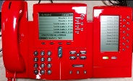
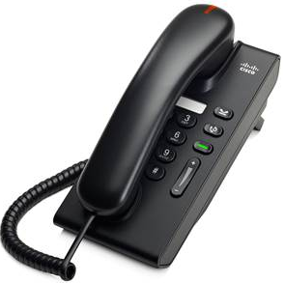

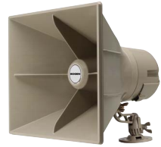
Proposed Crash Phone and Crash Alert System
XOP RFCS
Admin
PC
Master Phone
ATC Tower
Airport VLAN
Dedicated to Crash Network
Valcom
VIP-201A
Open
Firestation
Doors
Network Stations
Master Station at ATC Tower
Paging/Relay Station
IP Field Stations
PA
Bell
ARFF

Slide 7
XOP Networks RFCS - Benefits
Integrated Crash Phone and Crash Alert capability
99.999% Availability
Support legacy analog phones/devices and IP phones and IP based devices from the same system
Web based Administrator Interface
Multiple Configuration options -
  Different conferences can be set-up based on type and severity of emergency
  Different triggers can be used to initiate different conferences
  Conferences can also be set-up to be used for drills and routine checking of the communication infrastructure
Built-in recording feature that can be used during post emergency analysis
Flexible architecture – allows redesign (Adds, Moves and Changes) of the emergency network as the needs of the airport change

Slide 8
RFCS/Firebar Customers
Product deployed at several Manufacturing Plants, Independent Telcos, Power Plants, Airports, Government and Military installations

Slide 9
Ringdown Firebar Conference System
Platform Details
Cisco 4xxx Router
2 RU high, 19” wide, 15” deep
FXS, FXO and T1/E1/PRI Network Interface Modules
SIP Trunk (optional)
XOP Conference Software running on Cisco Service Module
Web Portal for System Administration/ Control
Solid State Hard Drive
Standard FXS NIC (10 Kft)
Loop extenders (30 Kft) (optional)
Support for IP Phones (optional)
High Availability (optional)
Information Assurance - Enhanced Security (optional)
SNMP Monitoring (optional)
Ringdown Firebar
Conference System
XOP Conf SW
Network Interface
Modules (FXS/FXO/PRI)
Service Module

Slide 10
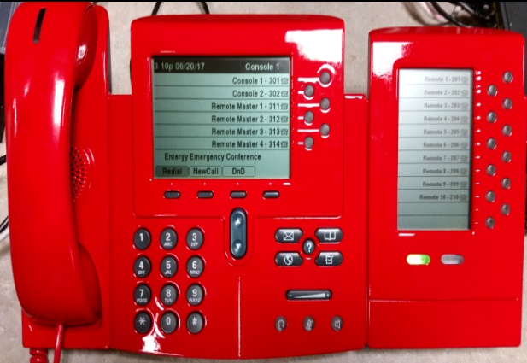
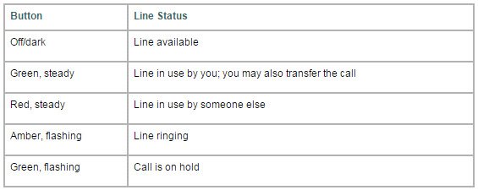
Ringdown Firebar Conference System
Supporting Devices
Console/ATC Phone w/line status
Cisco IP Phone +
Expansion module
Expansion Module LED Operation

Slide 11
Field Phones For Crash Phone
Ringdown Firebar Conference System
Supporting Devices
Available in Black, White, & Red (special order), Wall or Desk Mounting. The Cisco Unified IP Phone 6901 is a single-line endpoint delivering cost-effective access to Cisco Unified Communications. Designed with a low profile, the Cisco Unified IP Phone 6901 is an ideal solution for settings that have an occasional need for emergency communications.

Slide 12
Ringdown Firebar Conference System
Supporting Devices
Paging System Interface
VIP-201A SIP Paging Gateway is designed for use with virtually all IP based telephone systems. The unit provides SIP addressable groups and 1 analog output. The VIP-201A can control thousands of IP and/or analog speakers or provide interface to legacy paging systems. Connection to a SIP Server can be as individual SIP Stations (extensions) or as a SIP trunk. Station mode provides up to 8 SIP-addressable groups. Trunk mode accepts up to 100 SIP phone numbers for flexible grouping.

Slide 13
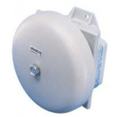
Alerting System Equipment
Ringdown Firebar Conference System
Supporting Devices
Emergency Initiation Button
Manufactured by Wheelock Company
Press to initiate
Press, rotate & release to cancel
Loud Ringer
Approvals include: UL Standard 464, Factory Mutual (FM), California State Fire Marshal (CSFM), New York (MEA) and Chicago (BFP)
Low frequency aluminum shells for better audibility through walls, doors and other structures

Slide 14
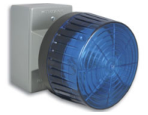

Alerting System Equipment's
Ringdown Firebar Conference System
Supporting Devices
The BLK-4 Blue Strobe Light provides high visibility indication of analog line status through a high powered 360º LED strobe and/or beacon visual indicator.
Phone Line to Relay Controller.
Open Firestation Doors
Turn on Firestation Lights

Slide 15

For additional information please visit our web site at
www.xopnetworks.com
For sales inquiries, please contact
Chris Bussey: Neelanshu Varma (India):
O:972-590-0206 (91) 9811488058
C:469-360-6061
cbussey@xopnetworks.com nvarma@xopnetworks.com
For general inquiries, please call
Main: 972-590-0200
Alternate: 972-590-0201
214-564-2263
Notes:
15

